Slide 1
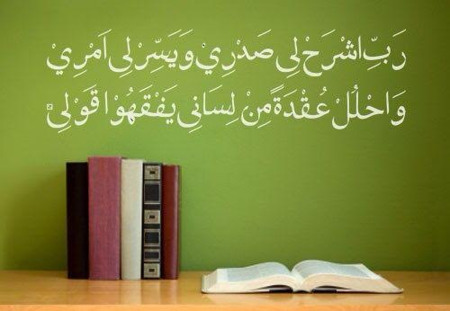
بسم اللہالرحمٰن الرحیم
My Lord, put my heart at peace for me,​ and make my task easy for me and remove the knot from my tongue, so that they may understand my speech.​
​​[20:24-28]​

Slide 2
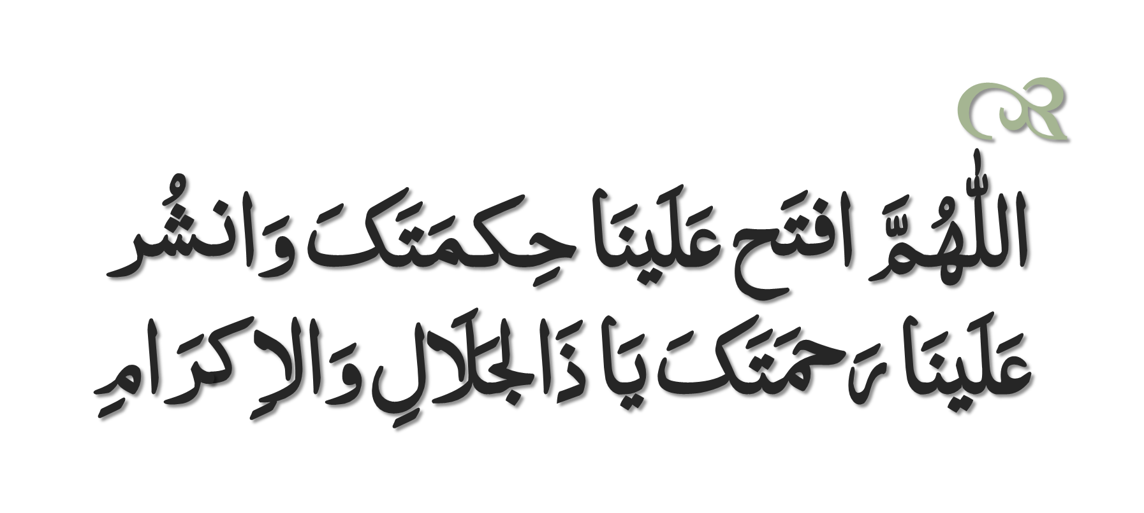
Dua to Recite Before Study

Slide 3
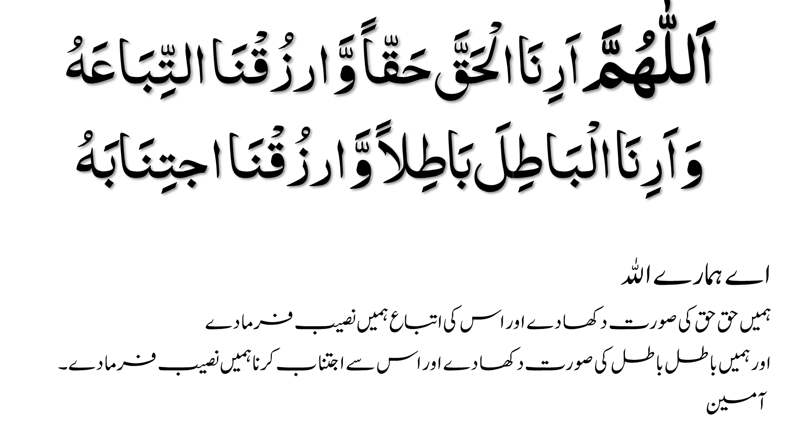

Slide 4
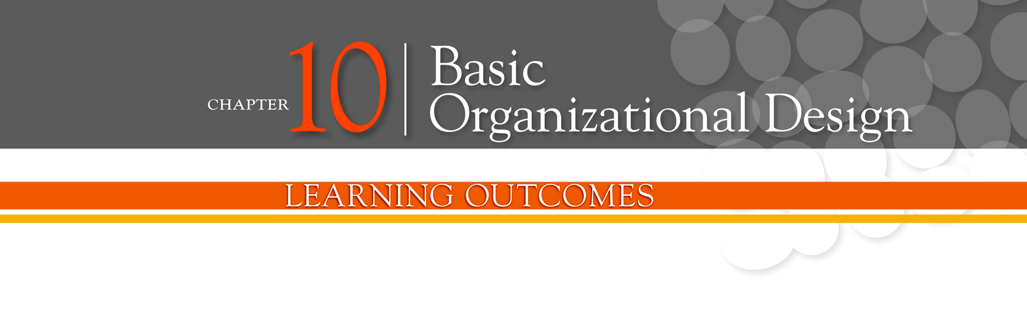
Describe six key elements in organizational design
Contrast mechanistic and organic structures
Discuss the contingency factors that favor either the mechanistic model or the organic model of organizational design
Describe traditional organizational designs

Slide 5
Designing Organizational Structure
Organizing - arranging and structuring work to accomplish an organization’s goals.
Organizational Structure - the formal arrangement of jobs within an organization.
Organizational Design - a process involving decisions about six key elements:
Work specialization
Departmentalization
Chain of command
Span of control
Centralization and decentralization
Formalization

Slide 6
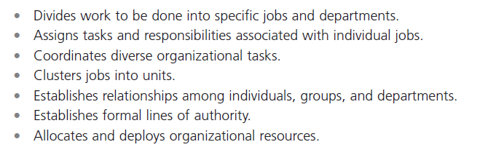
Exhibit 10-1: Purposes of Organizing
Notes:
Organizational structure is the formal arrangement of jobs within an organization. This structure, which can be shown visually in an organizational chart, also serves many purposes. (See Exhibit 10-1.)

Slide 7
Organizational Structure
Work Specialization
The degree to which tasks in the organization are divided into separate jobs with each step completed by a different person.
Overspecialization can result in human diseconomies such as boredom, fatigue, stress, poor quality, increased absenteeism, and higher turnover.

Slide 8
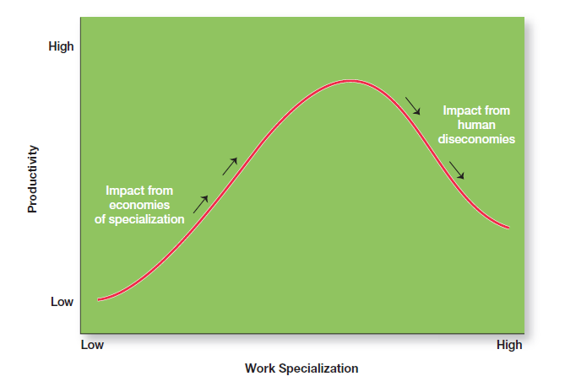
Exhibit 10-2: Economies and Diseconomies of Work Specialization
Notes:
As Exhibit 10-2 illustrates, at some point, the human diseconomies from division of labor—boredom, fatigue, stress, low productivity, poor quality, increased absenteeism, and high turnover—exceed the economic advantages.

Slide 9
Departmentalization by Type
Functional
Grouping jobs by functions performed
Product
Grouping jobs by product line
Geographical
Grouping jobs on the basis of territory or geography
Process
Grouping jobs on the basis of product or customer flow
Customer
Grouping jobs by type of customer and needs

Slide 10
Organizational Structure (cont.)
Chain of Command - the continuous line of authority that extends from upper levels of an organization to the lowest levels of the organization—clarifies who reports to whom.

Slide 11
Organizational Structure (cont.)
Authority - the rights inherent in a managerial position to tell people what to do and to expect them to do it.
Responsibility - the obligation or expectation to perform.
Unity of Command - the concept that a person should have one boss and should report only to that person.

Slide 12
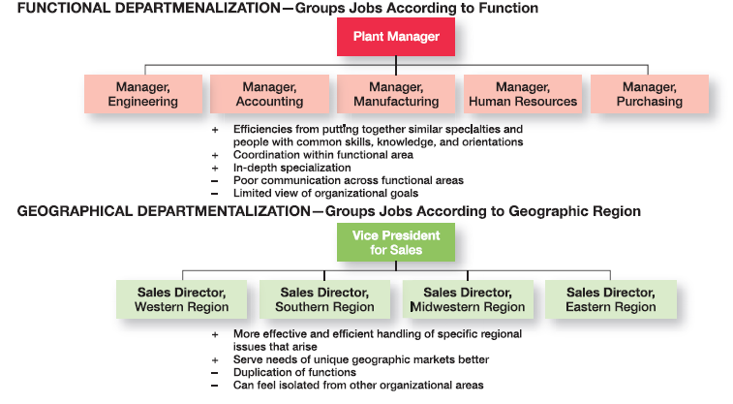
Exhibit 10-3: The Five Common Forms of Departmentalization
Notes:
Five common forms of departmentalization are used, although an organization may develop its own unique classification. (For instance, a hotel might have departments such as front desk operations, sales and catering, housekeeping and laundry, and maintenance.) Exhibit 10-3 illustrates each type of departmentalization as well as the advantages and disadvantages of each.

Slide 13
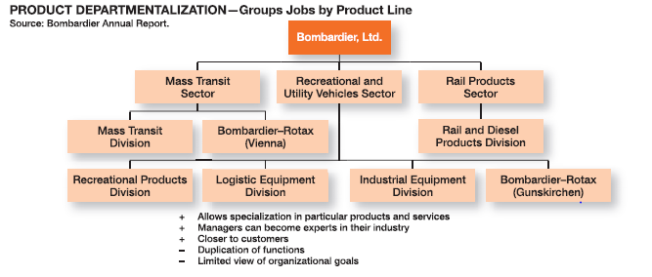
Exhibit 10-3: The Five Common Forms of Departmentalization (cont.)

Slide 14
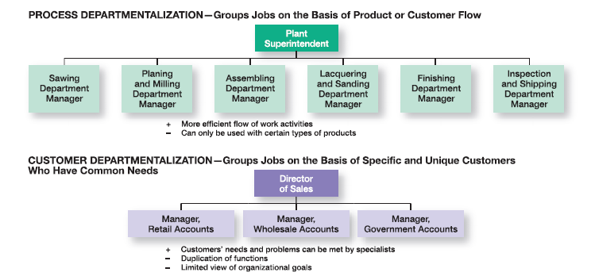
Exhibit 10-3: The Five Common Forms of Departmentalization (cont.)

Slide 15
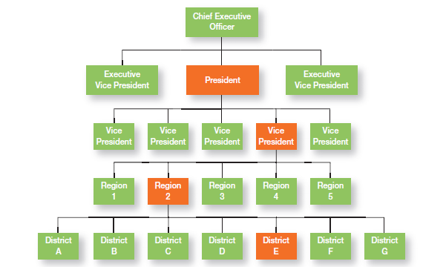
Exhibit 10-4: Chain of Command and Line Authority
Notes:
Line authority entitles a manager to direct the work of an employee. It is the employer-employee authority relationship that extends from the top of the organization to the lowest echelon, according to the chain of command, as shown in Exhibit 10-4.

Slide 16
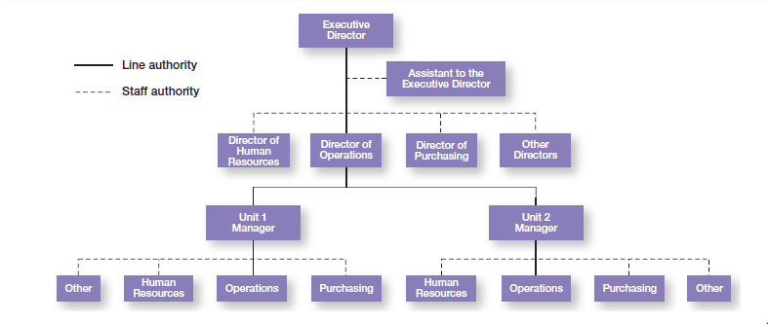
Exhibit 10-5: Line vs. Staff Authority
Notes:
Exhibit 10-5 illustrates line and staff authority.

Slide 17
Span of Control
Span of Control - the number of employees who can be effectively and efficiently supervised by a manager.

Slide 18
Width of span is affected by:
Skills and abilities of the manager
Employee characteristics
Characteristics of the work being done
Similarity of tasks
Complexity of tasks
Physical proximity of subordinates
Standardization of tasks
Sophistication of the organization’s information system
Strength of the organization’s culture
Preferred style of the manager

Slide 19
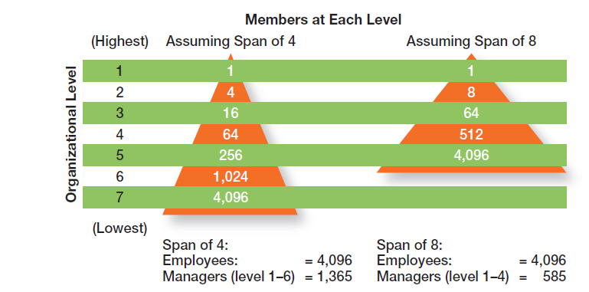
Exhibit 10-6: Contrasting Spans of Control
Notes:
Assume two organizations, both of which have approximately 4,100 employees. As Exhibit 10-6 shows, if one organization has a span of four and the other a span of eight, the organization with the wider span will have two fewer levels and approximately 800 fewer managers.

Slide 20
Centralization
Centralization - the degree to which decision making is concentrated at upper levels in the organization.
This is common in organizations in which top managers make all the decisions and lower-level employees simply carry out those orders.

Slide 21
Decentralization
Decentralization - when an organization relegates decision making to managers who are closest to the action.
Employee Empowerment
Increasing the decision-making authority (power) of employees

Slide 22
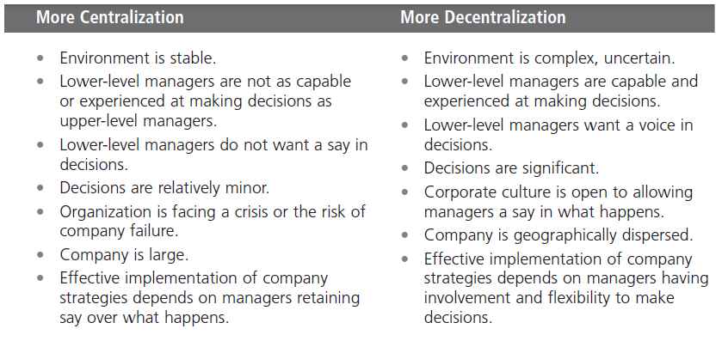
Exhibit 10-7: Centralization or Decentralization
Notes:
Exhibit 10-7 lists some of the factors that affect an organization’s use of centralization or decentralization.

Slide 23
Formalization
Formalization - the degree to which jobs within the organization are standardized and the extent to which employee behavior is guided by rules and procedures.
Highly formalized jobs offer little discretion over what is to be done.
Low formalization means fewer constraints on how employees do their work.

Slide 24
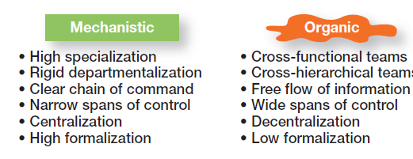
Exhibit 10-8: Mechanistic Versus Organic Organizations
Notes:
Designing (or redesigning) an organizational structure that works is important. Basic organizational design revolves around two organizational forms that are described in Exhibit 10-8

Slide 25
Contingency Factors
Structural decisions are influenced by:
Overall strategy of the organization
Size of the organization
Technology use employed by the organization
Degree of environmental uncertainty

Slide 26
Contingency Factors (cont.)
Strategy Frameworks:
Innovation
Pursuing competitive advantage through meaningful and unique innovations favors an organic structuring
Cost minimization
Focusing on tightly controlling costs requires a mechanistic structure for the organization

Slide 27
Contingency Factors (cont.)
Strategy and Structure
Achievement of strategic goals is facilitated by changes in organizational structure that accommodate and support change.
Size and Structure
As an organization grows larger, its structure tends to change from organic to mechanistic with increased specialization, departmentalization, centralization, and rules/regulations.

Slide 28
Contingency Factors (cont.)
Technology and Structure
Organizations adapt their structures to their technology.
Woodward’s classification of firms based on the complexity of the technology employed:
Unit production of single units or small batches
Mass production of large batches of output
Process production in continuous process of outputs
Routine technology = mechanistic organizations
Non-routine technology = organic organizations

Slide 29
Contingency Factors (cont.)
Environmental Uncertainty and Structure
Mechanistic organizational structures tend to be most effective in stable and simple environments.
The flexibility of organic organizational structures is better suited for dynamic and complex environments.

Slide 30
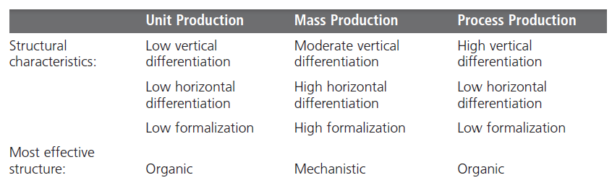
Exhibit 10-9: Woodward’s Findings on Technology and Structure
Notes:
Joan Woodward linked structural design elements to organizational success when she divided firms into three distinct technologies that had increasing levels of complexity and sophistication. The first category, unit production, described the production of items in units or small batches. The second category, mass production, described large-batch manufacturing. Finally, the third and most technically complex group, process production, included continuous process production. A summary of her findings is shown in
Exhibit 10-9.

Slide 31
Traditional Designs
Simple structure
Low departmentalization, wide spans of control, centralized authority, little formalization
Functional structure
Departmentalization by function
Operations, finance, marketing, human resources, and product research and development
Divisional structure
Composed of separate business units or divisions with limited autonomy under the coordination and control of the parent corporation

Slide 32
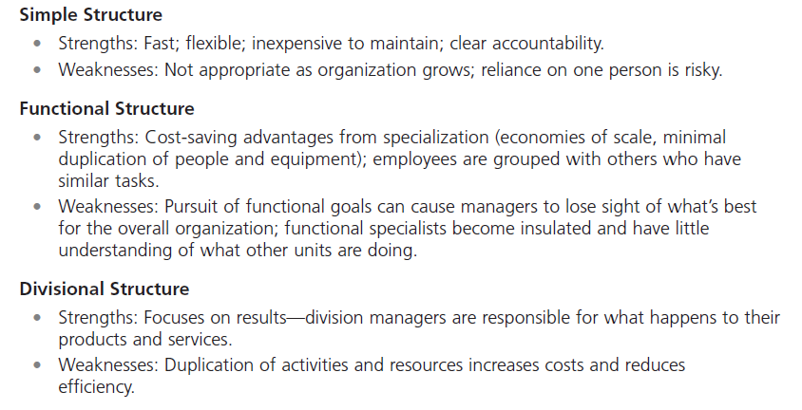
Exhibit 10-10: Traditional Organizational Designs
Notes:
When designing a structure, managers may choose one of the traditional organizational designs. These structures tend to be more mechanistic in nature. A summary of the strengths and weaknesses of each can be found in Exhibit 10-10

Slide 33
Terms to Know
organizing
organizational structure
organizational chart
organizational design
work specialization
departmentalization
cross-functional teams
chain of command
authority
responsibility
unity of command
span of control
centralization
decentralization
employee empowerment
formalization
mechanistic organization
organic organization
unit production
mass production
process production
simple structure
functional structure
divisional structure
team structure
matrix structure
project structure
boundaryless organization
virtual organization
network organization
learning organization

Slide 34
